Slide 1
Linux and Shell Fundamentals
“Don’t Fear The Command-line Edition”
Notes:
Intro 101

Slide 2
Agenda
Introduction
Command Substitutions
File Operations
I/O Redirection
Conditionals and Control Flow
Multitasking and Job Control
Utilities and Tools

Slide 3
Unix Architecture
Hardware layer
consists of all peripheral devices (RAM/ HDD/ CPU etc).
Kernel
interacts directly with hardware, provides low level services to upper layer components.
Shell
interface to kernel, hiding complexity of kernel's functions from users
Utilities
utility programs giving user most of the functionalities of an operating systems
Notes:
Unix layered architecture
Hardware initialization
Unix goes far back
Kernel services
TTY support
Tightly coupled I/O hardware
VT100
Role of the ttyin the embedded systems space

Slide 4
Some basic terms
TTY
Terminal
Shell
Console
Virtual Terminal
Notes:
They sound similar, often mistakenly used interchangably but what are they?

Slide 5
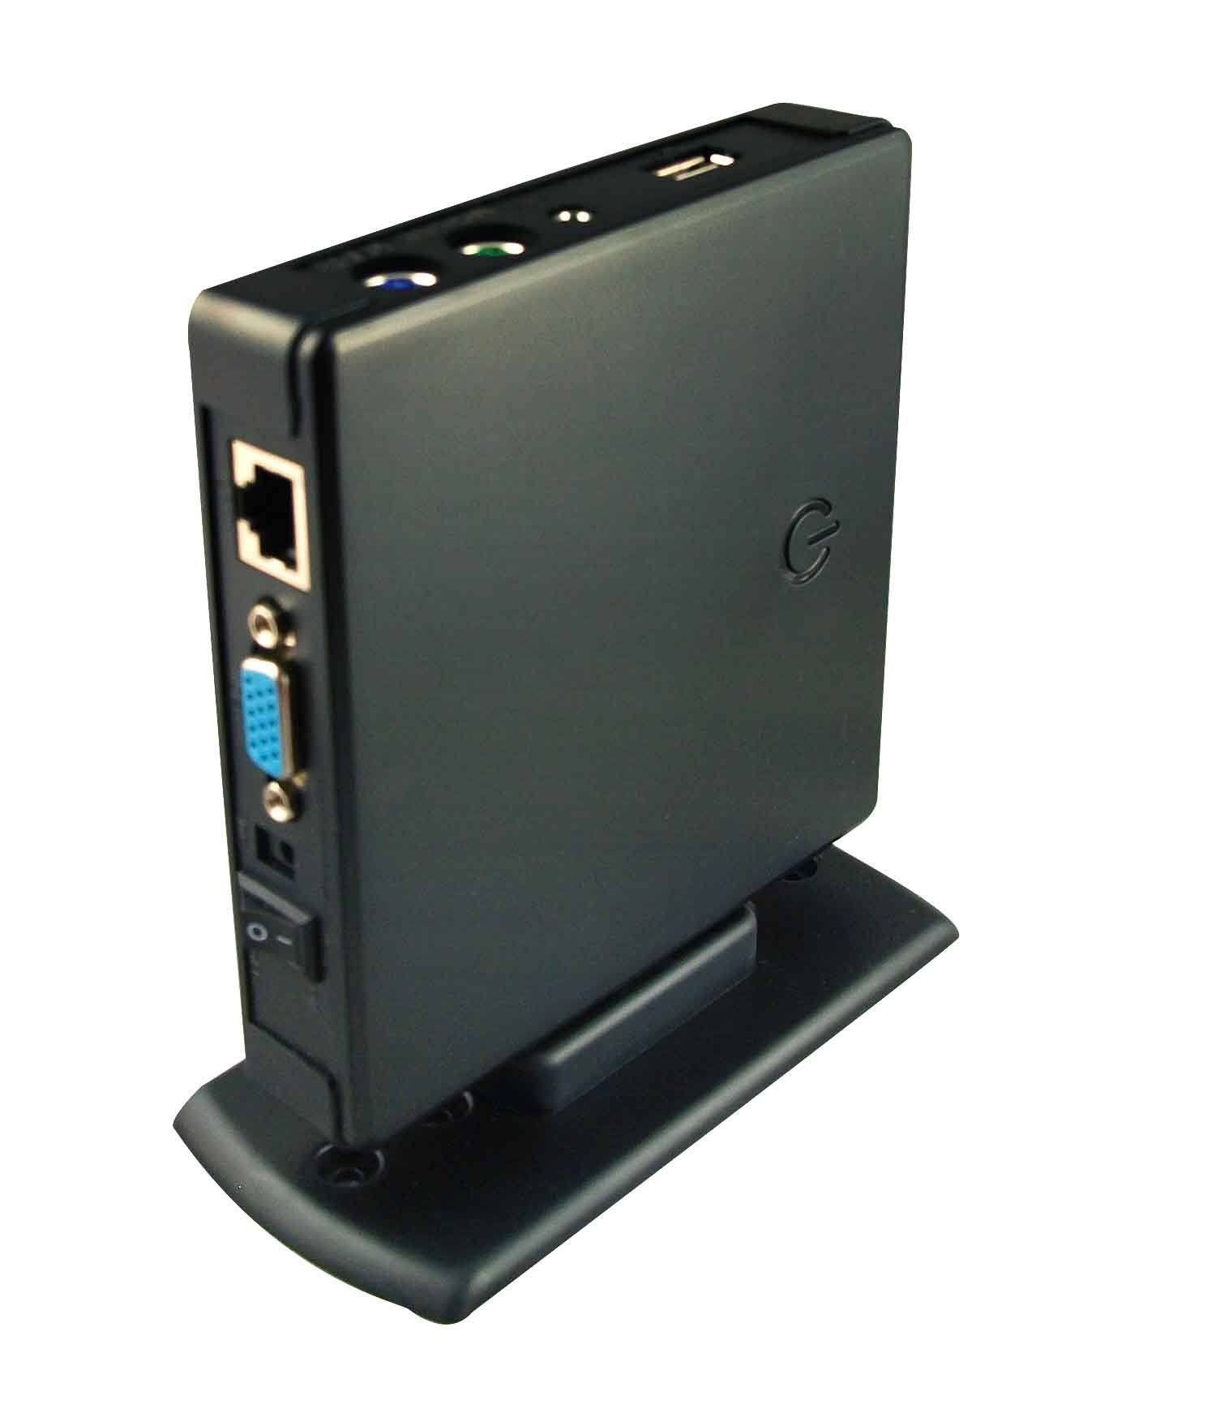
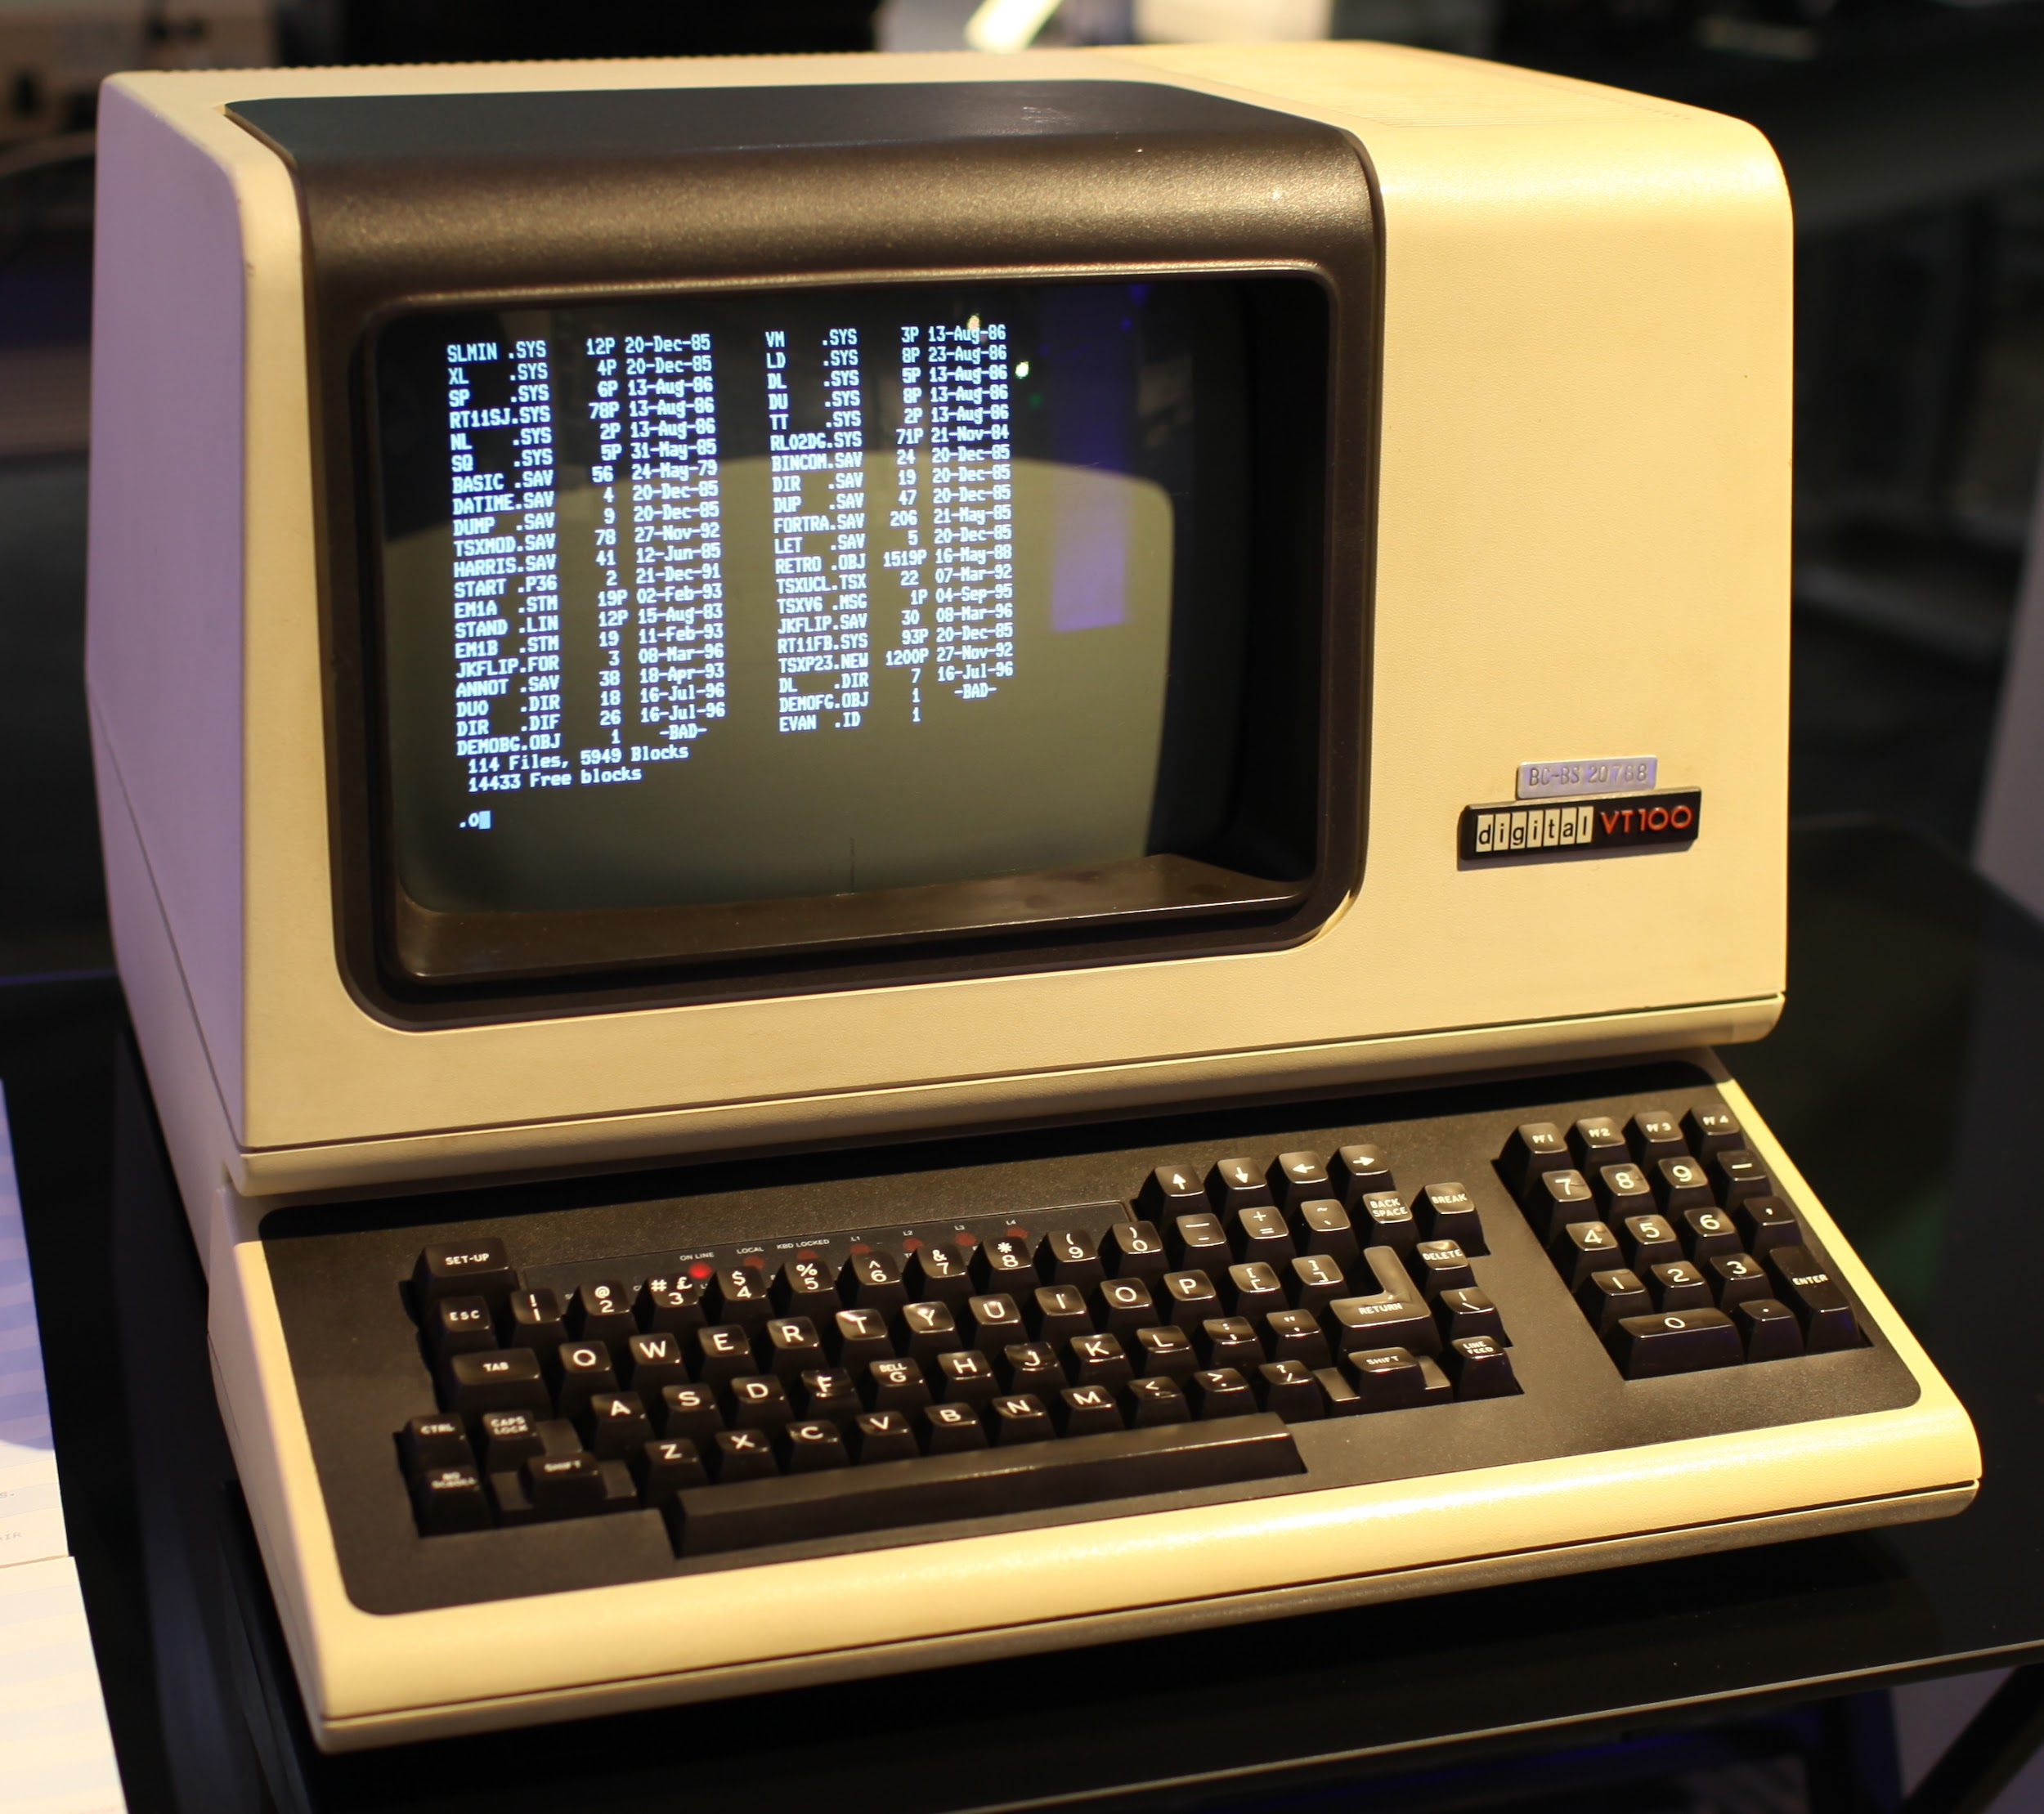
Terminal / TeleTYpewriter
VT100
Thin-Clients
Notes:
tty is a particular kind of device file which implements a number of additional commands (ioctls) beyond read and write.
VT100 is the yesteryear and the Thin-client of today
Scroll back buffers, scroll lock

Slide 6
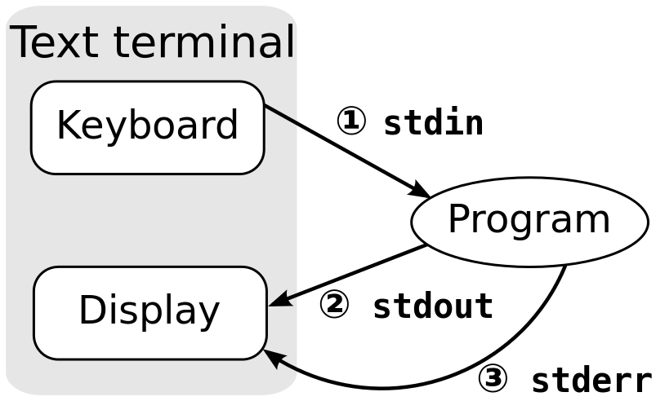
Terminal Emulators
Apps that put up a window and let you interact with the shell
Xterm / rxvt
Gnome-terminal
Konsole
Terminal app (OS X)
Notes:
Provided by your desktop environment
Features - tiling, panning, appearance, scrollback buffers

Slide 7
Shell ?
A user interface for access to an operating system's services
Requires know-how of how to operate
Depends on available input devices
UI can differ among shells:
Command-line based
Graphics based
Notes:
Command line shell
GUI shell
GUI: more sophisticated nomenclature: window managers, desktop environments, screen compositors
Bashrc
Sshkey pair generation
Change environment
Aliases
Sshkey won’t work in case the permission is not private 400
How to change shell

Slide 8
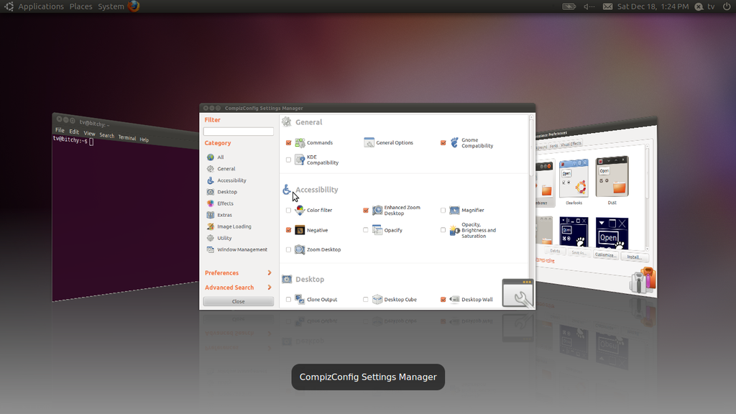
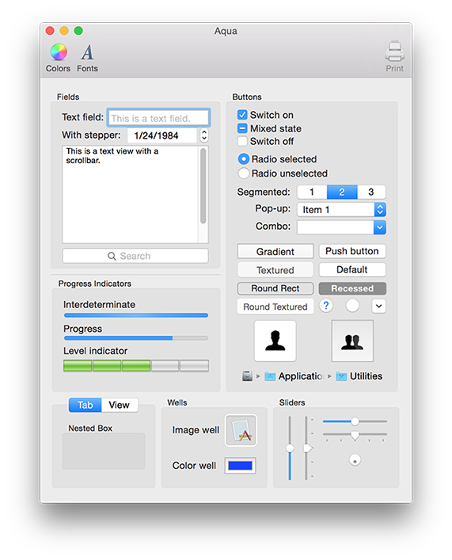
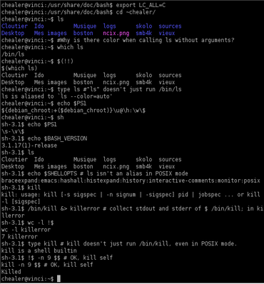

Slide 9
Timeline
Bourne Shell (sh)
C Shell (csh)
Korn Shell (ksh)
Bourne-Again Shell (bash)
Notes:
Sh - Berkeley (not GPL) - Control structures/language, clean but primitive
Csh - AT&T (Dave Korn) - Job Control, command editing, history
Ksh - Sun OS (Bill Joy) - Invaluable features
Bash - FSF/GPL - Features of all

Slide 10
Other Useful/Interesting Shells
Alquimist Shell (ash/dash)
Z Shell (zsh)
Friendly interactive shell (fish)
Xiki Shell
Notes:
https://www.youtube.com/watch?v=bUR_eUVcABg

Slide 11
Docker
What is it?
Why do we use it?
How to use it
Notes:
What is it: It is a software solution to create containers to achieve os level virtualization easily
Why do we use it:
Isolated environment for your apps
Better for stateless applications
Easy to scale and deploy
“Developers use Docker to eliminate “works on my machine” problems when collaborating on code with co-workers”
Bare minimum requirements thus making packaging easier
How to use it: demonstrate by creating docker file and making a ubuntu14 image

Slide 12
Creating files and Directories
Touch
Cat command (Here document)
Editors
Nano
Vi / Vim
Emacs
Notes:
Touch -t CCYYMMDDHHss

Slide 13
Comparing files
Diff and Patch commands
Checksums
MD5
SHA1

Slide 14
Archival and Compression
Tarballs
tar
Compression
Gzip
Bzip2
Xz/lzma
Encoding
base64
Encryption
Gpg
Crypt
openssl

Slide 15
File permissions
Sticky bits
SetUID check flag!
User permissions
Group permissions
Chmod
Chown
Chgrp

Slide 16
Shell I/O and Redirections
File descriptors
Usage in shells
Redirection
To file
To stderr
To stdout
Redirecting within file descriptors
Sort unique wc:imp
Save when forgot to sudo file: esc+:w !sudot%
Notes:
Explain tee after a redirection

Slide 17
Pipeline Operator
Unix toolkit philosophy
Using “|” to forward output to other commands
Internals of how it works
Execution and control flow

Slide 18
Advanced - Multitasking
Sending processes to background
Ampersand (&) operator
Understanding $!, $$, $PID and $PPID, $?
Viewing background jobs
jobs command
Bringing jobs to foreground
Notes:
$!-recent process
$$-current process(shell)

Slide 19
Advanced - Multitasking
Keeping processes in the background
Nohup
Linger
Parallelizing tasks with xargs

Slide 20
Advanced - Screen multiplexers
GNU Screen
Tmux
Apt:for debian
Upgrade:to upgrade
Apt-get install/remove/purge
Ssh -i privatekey username @ ip
Scp -r -i prvtkey source destination@ip:
Tar -xvf:untar
Tar-cvf:tar
Gzip filename
Gzip-d: unzip
Notes:
Brief intro to Tmux and screen why we need it
Basic options
Iterm if possible (if majority of them have mac)

Slide 21
Other basic Utilities
Wget: non-interactive downloader
Curl: transfer data to/from a web server, -r:header,-v,-H,--cookie,-L
Ping: test whether an address/hostname is up,-c
Dig: resolve a hostname to IP address
Netstat: check all listening ports on a server
Scp: copy data to a remote dest over ssh
Rsync: keep remote/local directories in sync
Cron: scheduled tasks
Ln: symbolic Links
Simple python server:
Notes:
Demonstrate use of each command with a few examples.
Rsync -a
Ps aux
Htop
Top

Slide 22
Searching files
Find command
Named
Wildcard
Exec
Grep
Literals/Regex
Case-insensitive
Word
Recursive

Slide 23
Stream Manipulator and Extractors
Sed: Stream Editor
Awk: Text Extraction and Processing

Slide 24
Restrictions in the Infra
Notes:
Error log and access log separate
Use data from common place
/var/log
java -Xmx256M -jar MyApp.jar

Slide 25
Advanced - Customizing the prompt
PS1 variable
PS2 variable
Character sequences
Theming your shell:
Bashish
Powerline
Notes:
If time is there then we can cover this

